Slide 1
Spotify Recommender System
Yi (Betty) Chen, Yuexin (Cindy) Chen, Yiyang (Jade) Cao, Ruoxuan (Michelle) Liu

Slide 2
Agenda
Abstract
Business Objective & Significance
Paper review and Model approach
Data Analysis and Model Building
EDA
PCA
Clustering Analysis
Recommender Systems
Result and Application

Slide 3
Abstract
Spotify’s dataset contains diverse information about songs such as their artists, popularity, and genres. Significant business values can be generated if the dataset is used to encourage users to explore new songs similar to their current interest.
To achieve this, we first performed PCA and Clustering Analysis to identify groups of similar songs. Then we built recommender systems to recommend songs in the same cluster. In application, the song recommended would be enjoyed by the user.

Slide 4
Business Significance
With a recommender system, Spotify can
Increase the level of user engagement in terms of time spent in App
Increase the level of user satisfaction
Create an unique experience for user to increase the level of user loyalty
Further promote the most popular tracks (with popularity based recom. system) to increase revenue
Introduce additional musical niches (with content based recom. system) to increase retention rate
With a combination of two recommender systems, Spotify can
Distinguish the experience between premium and non-premium users
Premium: with the option to choose either popularity based or content based recom. system based on their preference
Non-premium: only popularity based recom. system

Slide 5
Paper Review & Inspiration
"Content-driven Music Recommendation: Evolution, State of the Art, and Challenges" by Deldjoo, Schedl, and Knees
Define music recommendation and explaining its importance in the current digital age
Provides an overview of the different types of audio features used in content-based music recommendation systems
Review the different approaches to modeling and representing music in content-based recommendation systems
“Movie Recommender System Using K-Means Clustering AND K-Nearest Neighbor” by Ahuja, Rishabh, et al.
Inspire us to use K-means result to implement popularity based recommender system

Slide 6
Data Source and Data Cleaning
Spotify Tracks Dataset on Kaggle
114000 rows
21 columns
Columns kept
Artists, album_name, track_name, track_genre, popularity, duration_ms, danceability, energy, loudness, speechiness, acousticness, instrumentalness, liveness, valence, tempo
Categorical variables are in green
Numeric variables are in blue
Rows kept
If two rows have the same values for all columns other than track_genre, then they are considered duplicates
Duplicates are removed

Slide 7
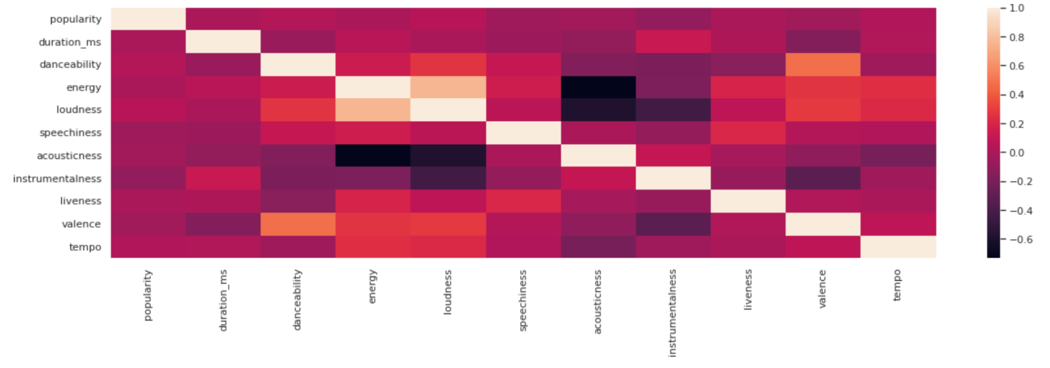
EDA: Correlation Plot
Most of the features are not highly correlated.
Loudness and energy is highly correlated.
Acousticness is negatively correlated with loudness and energy.

Slide 8
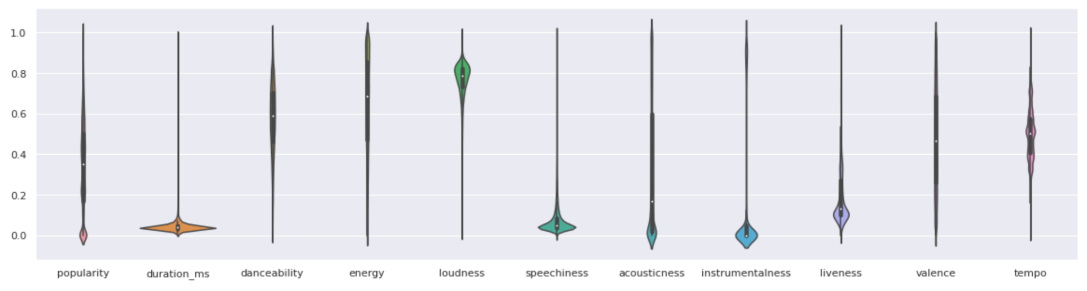
EDA: Distribution Plot
Most of the features is not normally distributed.
We choose to normalize data (min max scale).

Slide 9
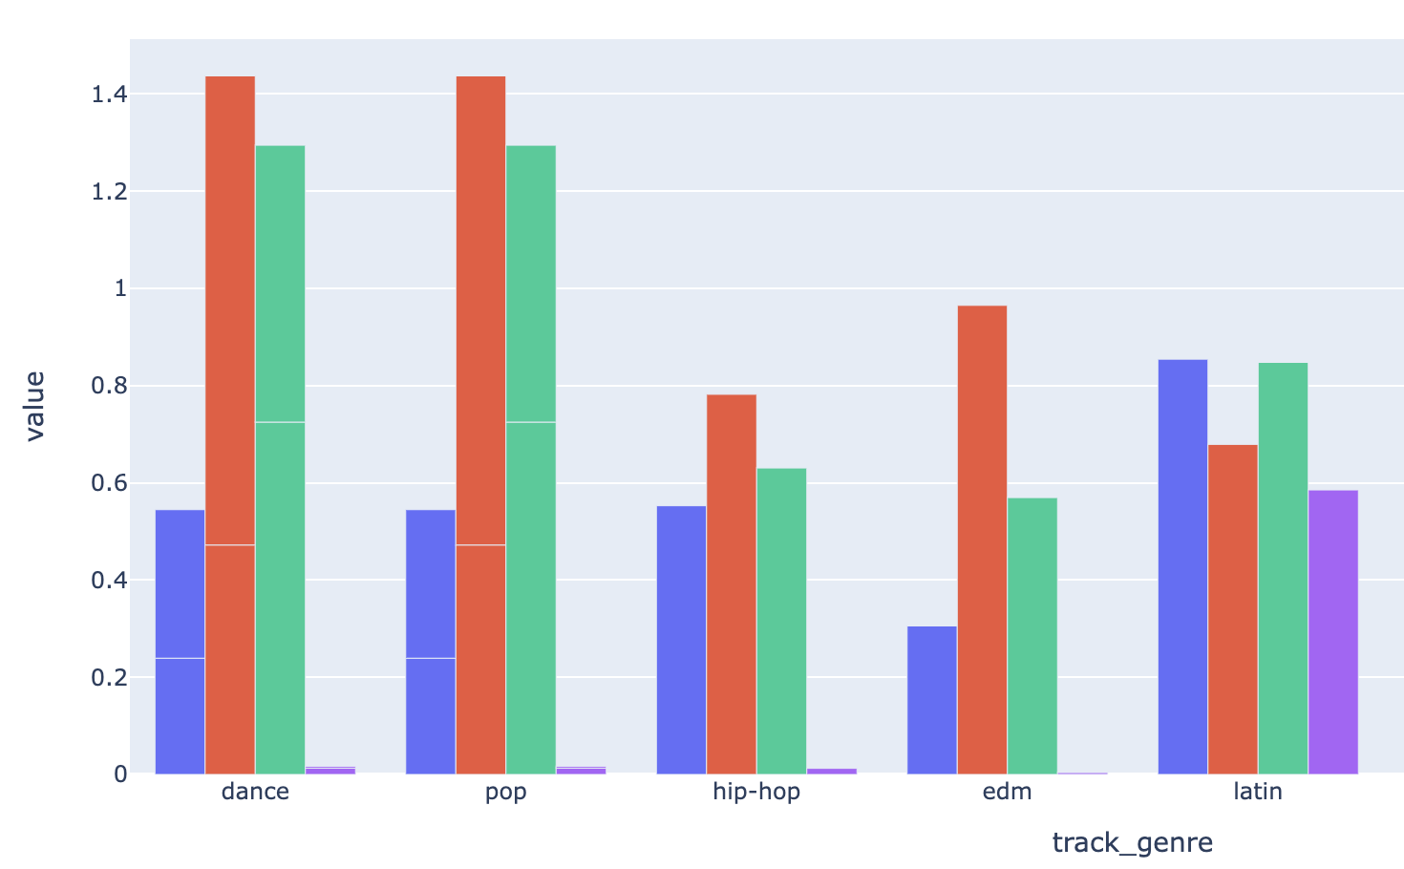
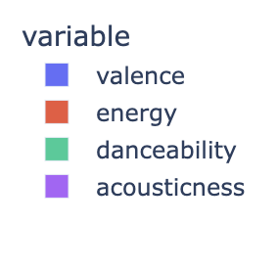
EDA: Characteristics of Different Genre
Dance and Pop have similar characteristics, having relatively high danceability and energy.
Latin have relatively high acousticness.
Dance, pop, hip-hop, and EDM have similar valence.

Slide 10
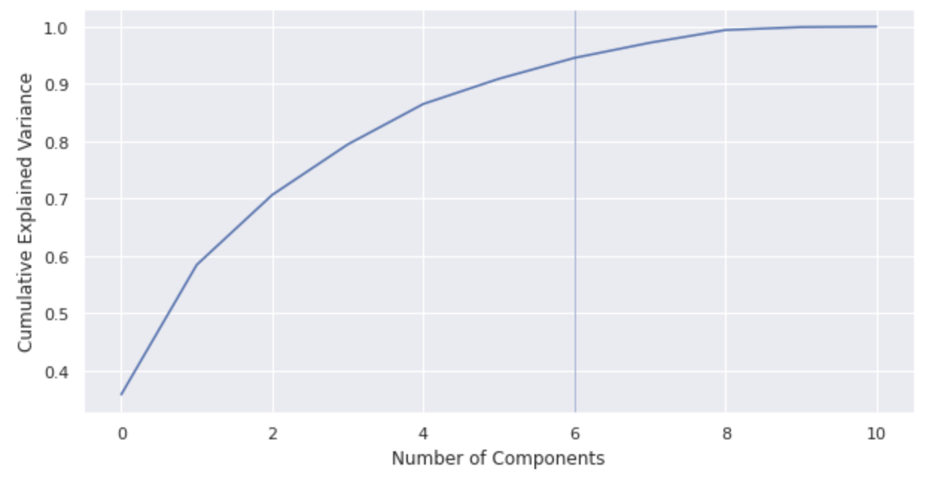
PCA
Explain 95% variances of data.
Dimension reduced from 11 to 6.
Use the 6 PCs to clustering analysis.

Slide 11
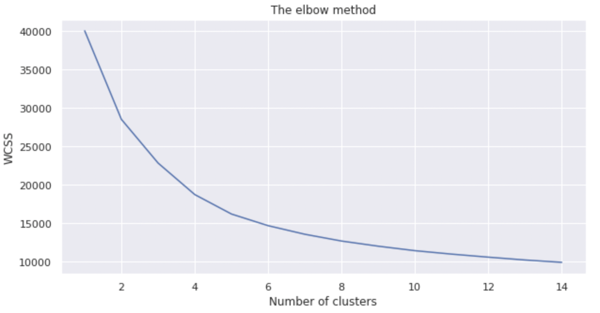
Clustering - K-Means
Although the elbow point is around 4, due to the large number of tracks, we decided to choose 8 as the number of clusters

Slide 12
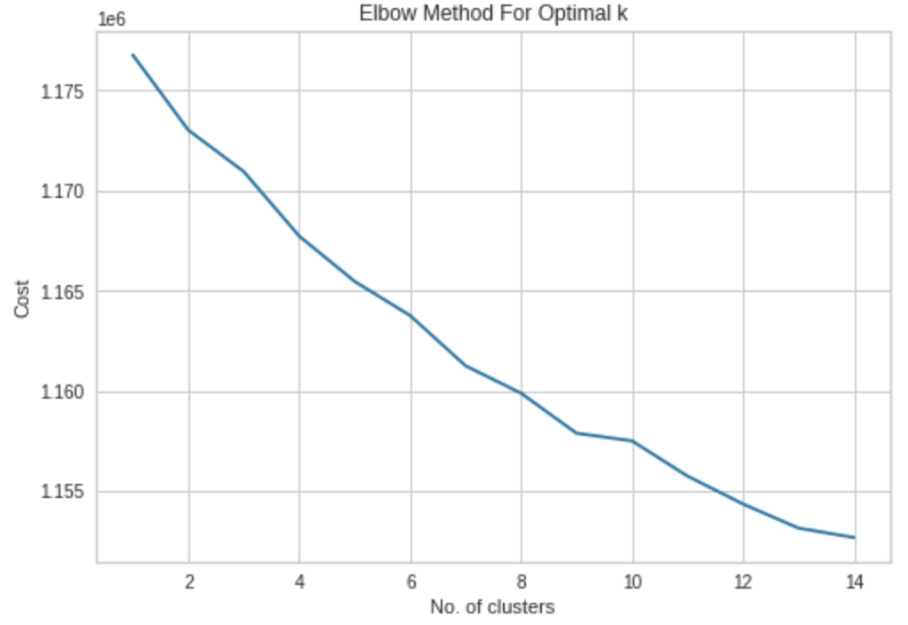
Clustering - K-Modes
Based on the elbow plot, number of clusters is 9
Since the optimal number of clusters selected is really similar to the number from K-Means, we decided to use K-Means
K-Modes is also extremely computationally expensive

Slide 13
Recommender System - Popularity Based
We prompt users to type in their favorite track name and album. Our algorithm will find the cluster (K-means result) that the user’s input song belongs to, and then return the most popular song within the same cluster.
Benefits:
Simple to implement
Still include some extend of personalized recommendations to users based on their previous preferences
Demo video

Slide 14
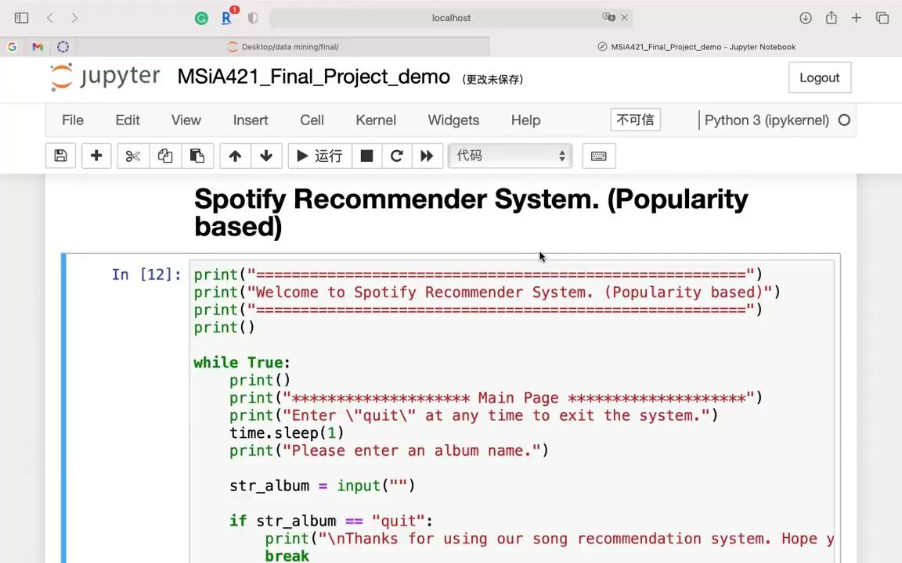

Slide 15
Recommender System - Content Based
We prompt users to type in their favorite track name and album. Our algorithm will analyze the attributes of users’ favorite songs, including dancibility, energy, loudness, the sentiments contained in the songs’ name (e.g. Polarity) and so on. And then recommend the most similar song based on these attributes.
Benefits:
Simple to implement
Easy to understand
No data of users is required
Demo video

Slide 16
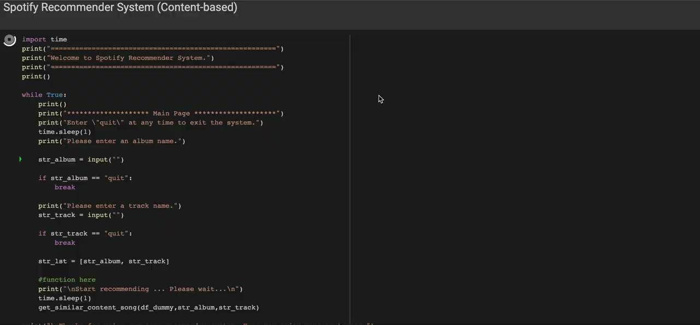

Slide 17
Future Steps
User ratings for songs
Collaborative Filtering recommender system
User demographic information
“Music Recommendation System Based on Emotion, Age and Ethnicity” by Mammadli, Ramiz, et al.
Emotion, age, and ethnicity are extracted from face data with convolutional neural networks
Enters a web site → an image of the user is captured → songs are recommended
Practical and ethical concerns, but worth investigating

Slide 18
Reference
Appendix
Data source: www.kaggle.com/datasets/maharshipandya/-spotify-tracks-dataset
Ahuja, Rishabh, et al. “Movie Recommender System Using K-Means Clustering and K-Nearest Neighbor.” 2019 9th International Conference on Cloud Computing, Data Science &amp; Engineering (Confluence), 2019, https://doi.org/10.1109/confluence.2019.8776969.
Chang, Eric. “Building a Song Recommendation System with Spotify.” Medium, Towards Data Science, 17 Dec. 2021, towardsdatascience.com/part-iii-building-a-song- recommendation-system-with-spotify-cf76b52705e7.
Deldjoo, Schedl, and Knees. "Content-driven music recommendation: Evolution, state of the art, and challenges." arXiv preprint arXiv:2107.11803, 2021.
Mammadli, Ramiz, et al. “Music Recommendation System Based on Emotion, Age and Ethnicity.” arXiv.org, 2022.
https://colab.research.google.com/drive/187P_uPlTCkleVASo8ZvGQYkyy_L9Z5SA?usp=sharing

Slide 19
Q&A

Slide 20
Thank you!

